Slide 1
Generalized Least Squares

Slide 2
Overview
How does GLS differ from ordinary least-squares?
Identifying and describing autocorrelation
Regularly and irregularly spaced data

Slide 3
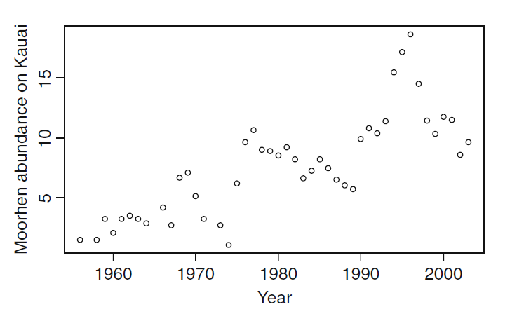
Relaxing Linear Model Assumptions:
Independence
Data can be auto-correlated
Often for temporally or spatially structured data, assumptions of independence are not valid
Ex: How does rainfall affect bird populations?

Slide 4


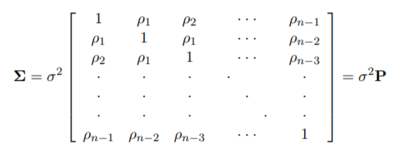
Two minutes of matrix algebra
Standard linear models can be expressed:
y is n x 1 response vector
X is n x k+1 matrix of data
β is k+1 x 1 vector of regression coefficients
ε is n x 1 vector of residuals
ε is assumed to have a mean of zero, and variance σ²
No covariance allowed (OLS)
In GLS, we create an variance-covariance matrix that describes a correlation structure of residuals
In OLS, this is just an identity matrix

Slide 5
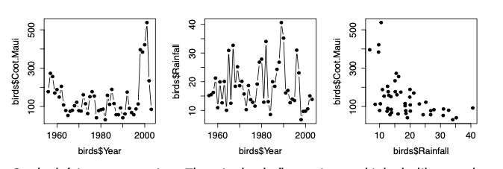
Example: Hawaiian Coots from Maui
Goal: make a model for the relationship between rainfall and coot abundance
Model the temporal correlation of residuals
Estimate the effects of any predictors (rainfall in this case)
Notes:
In the previous slides example, the matrix has only four elements, but imagine that it includes all observations in the dataset. For a time series, these would be residuals for year 1, 2, 3, and 4. By treating the residuals as a vector drawn from a multivariate distribution, we can explicitly model any correlation among the residuals. This allows us to 1) learn things about the residual correlation structure, and 2) allow a regression model of a time series (or spatial dataset, etc.) to have assumptions that match the nature of the data.
On the left is coots over time. There is clearly fluctuation, and it looks like samples in adjacent years are similar. The second plot shows rainfall over time, which also fluctuates considerably. The third plot compares coot abundance to rainfall, and it look like there is a negative relationship.

Slide 6
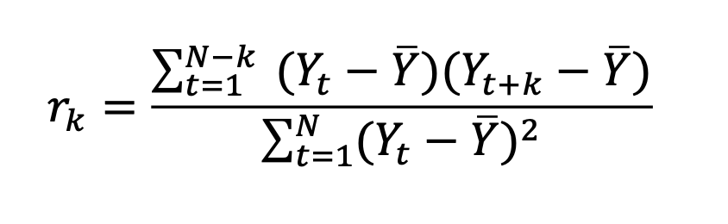
Exploring the temporal structure of the data
The covariance between observations at time t and observations at time t+k
Sum of squares of the data, which makes the correlation range between 0 and 1
We can plot this equation with the acf() function…
Notes:
Explore the temporal structure of the data. The most common way to do this is by plotting the autocorrelation function. The autocorrelation function is just the correlation between the time series and itself, at different lags. We can write it like this:
rk is the correlation at lag k, N is the length of the time series, Yt is the observation at time t. The top of this fraction is just the equation for the covariance between observations at time t and observations at time t+k; the bottom is the sum of squares of the data, which makes the correlation range between 0 and 1. We can plot it with acf():

Slide 7
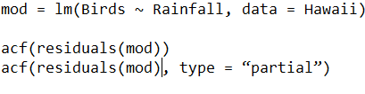
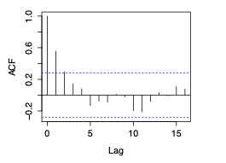
Recognizing autocorrelation – regularly spaced data
Auto-correlation plot
Show correlation between data points of different lag distances
Partial acf is similar, but corrects for correlation caused by lower lag steps
Notes:
Re: the plot for coot data
This function plots the estimated autocorrelation at each lag, plus a dotted line that approximates the threshold at which the correlation is significantly different from zero. The correlation at lag 0 is 1, which is plotted for reference. For the coots the correlation at lag 1 is about 0.6, and at lag 2 is about 0.3. So, observations within 1 or 2 years of each other are correlated, and after that there is not much signal of correlation. We can think of various reasons why observations within 1-2 years of each other might be similar. Coots live for more than one year, so if there is a good year for coot reproduction/survival, the population size could remain high for multiple years. If coots move around, but we sample at one location, then if the location tends to be good/bad for multiple years in a row, that could produce a similar signal.

Slide 8

ARMA correlation structure
Autoregressive correlation structure:
Parameter p determines the lag of the autocorrelation
Moving average correlation structure:
Parameter q determines moving average lag
Can combine AR and MA to make ARMA, with parameters (p, q)
Zuur: “The ARMA(p, q) can be seen as a black box to fix residual correlation problems”

Slide 9

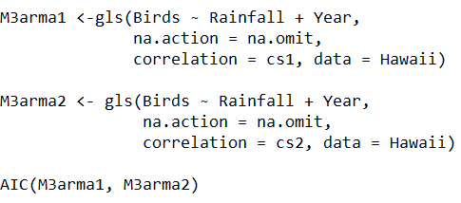
Implementation
Package nlme
corARMA
Starting value somewhat arbitrary
gls()
Works like lm(), but allows for definition of correlation structure
Determine best correlation structure by model comparison with AIC

Slide 10
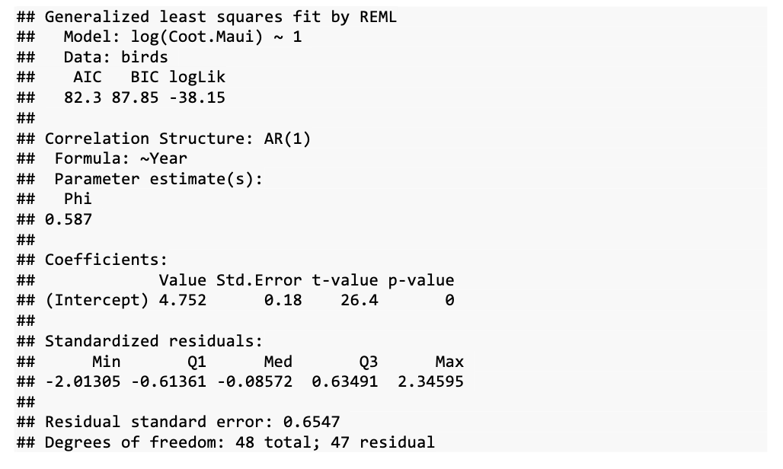
Specifying an AR model for our data
?corStruct - will display the wide variety of correlation structures possible
To model autocorrelation between each site:
corAR1(form =~ Year|Site)
Notes:
this model will fit an intercept (the mean of the data), and it will model the correlation in the residuals around that mean. The specification is the same as lm(), plus an extra ‘correlation’ argument, ‘corAR1(form = ~ Year))’. The correlation argument can use a wide variety of correlation structures, which you can see by looking at ?corStruct. This is an AR(1) model for the residuals which uses the function corAR1(). Inside this function we tell it how to order the residuals in time, with form = ~ Year. If we had time series from multiple sites, and wanted to model autocorrelation within each site separately, then we could modify the formula like this: form = ~ Year | Site.
We only have two parameters in this model, the intercept and phi. Phi is estimated to be 0.59, which is fairly strong correlation between successive years. To visualize
what the AR(1) structure is doing, we can compare the raw residuals, i.e. log(Coot.Maui) – (Intercept), to the ‘normalized’ residuals that account for the AR(1) structure and display the ‘left over’ variation.

Slide 11
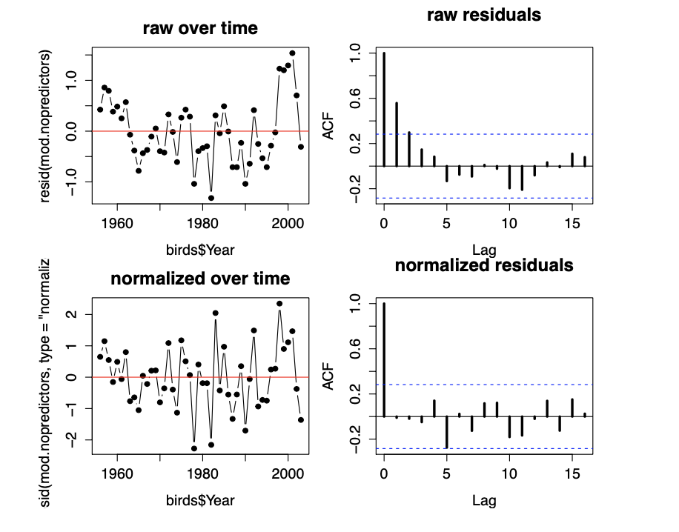
Raw versus normalized
This model accounts for the temporal correlation of residuals (goal #1)
Now we need to account for rainfall (goal #2)
Notes:
Here I’ve plotted both raw and normalized residuals, as a time series and using acf(). The raw residuals show the same pattern as when we did acf() on the raw data, which is how it should be, because this model has no predictors.
The normalized residuals show no significant autocorrelation, especially not at lags 1 and 2, which were the problematic ones.
Likewise, the time series looks more like it just bounces around randomly, compared to the raw residuals. It looks like the variance may increase a little over time, but it’s not so bad that I will worry about it. From this we can conclude that the AR(1) model is sufficient to account for the temporal structure of this data, in the sense of making a regression model with assumptions consistent with the data.

Slide 12

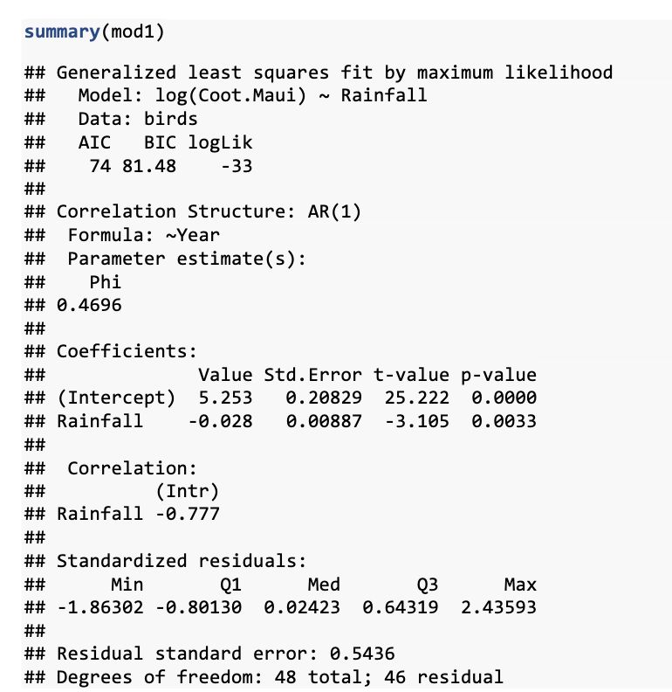
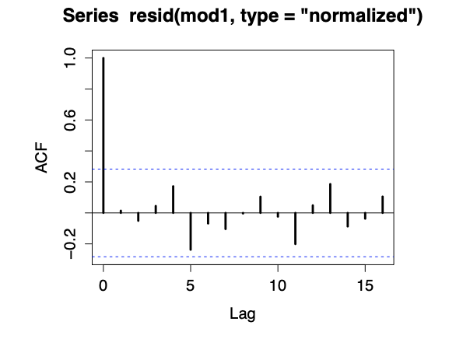
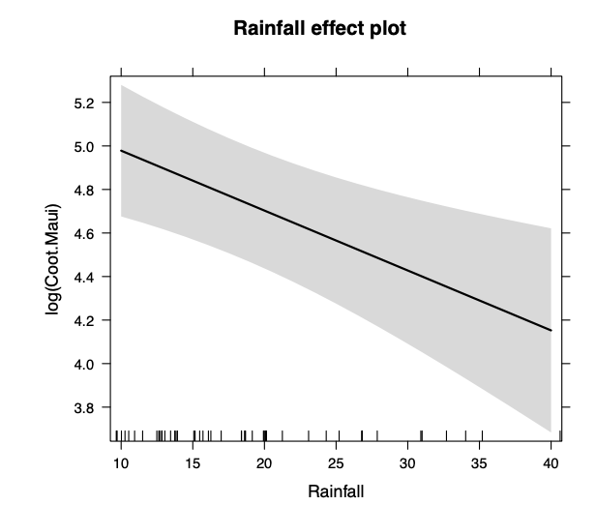
Modeling temporal correlation of residuals + estimating effect of rainfall
Notes:
The effect size for rainfall is reasonably large. Over the range of observed rainfall, coots are expected to vary from exp(5) = 148 to exp(4.2) = 67.

Slide 13
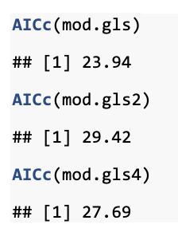
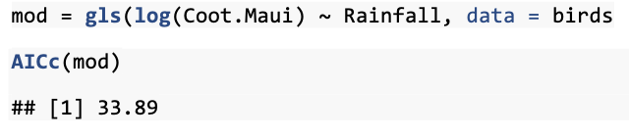
AR versus ARMA correlation structure
Comparison to gls() without accounting for complexity of residuals:
Notes:
We would consider these more complex correlation structures if the AR(1) didn’t appear sufficient. And we could compare among these options using AIC:

Slide 14
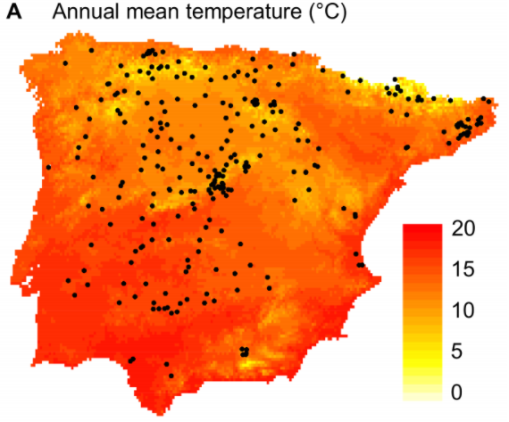
Irregularly spaced data
Approach is conceptually similar
Look for evidence of autocorrelation
Find an appropriate model to describe autocorrelation
Flowering time of Arabidopsis in Spain & Portugal

Slide 15
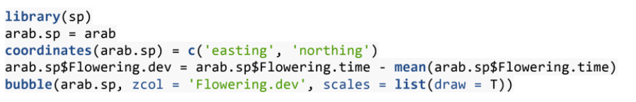
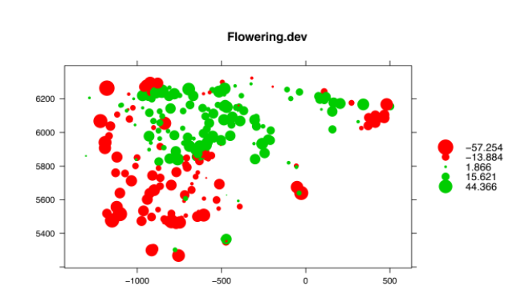
Identifying spatial autocorrelation
Start by plot deviation from mean in 2d space with bubble ()

Slide 16
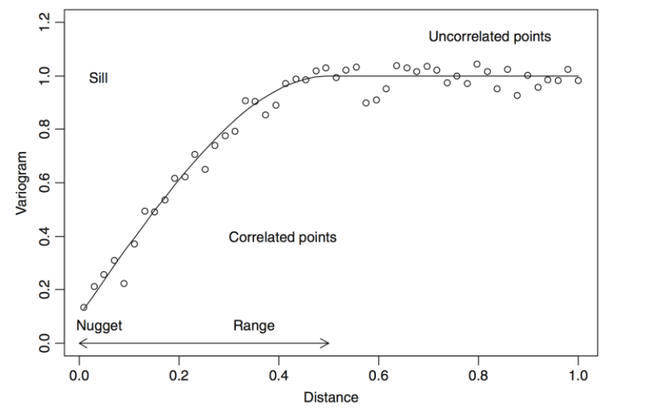
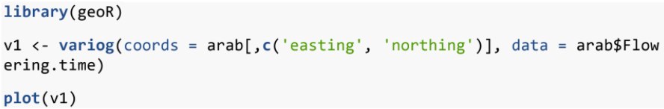
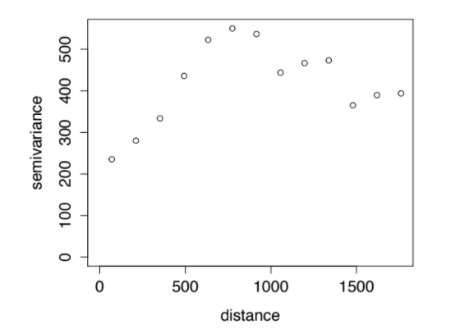
Using a variogram to identify autocorrelation
idealized
Plots variance as a function of distance between sample points
“nugget” is variance at zero distance
“sill” is the asymptote value
“range” is distance where variogram levels

Slide 17
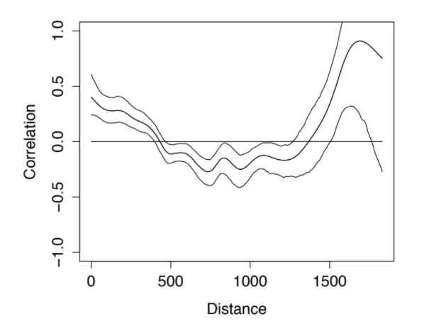
Using a spline correlogram
Plots correlation as a function of distance between sample points
Non-parametric estimator to get smooth function for correlation

Slide 18
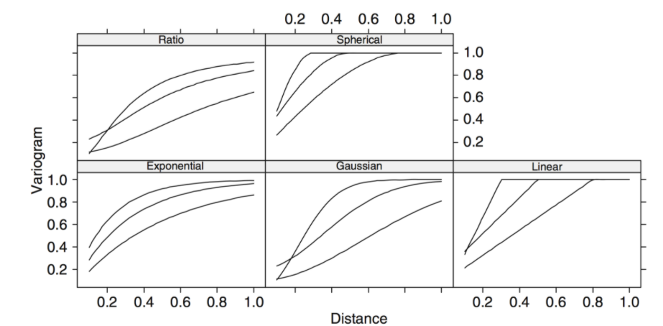
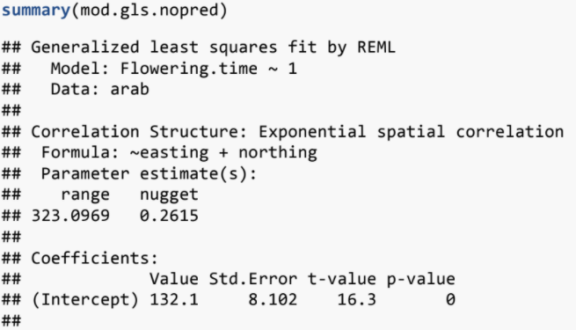
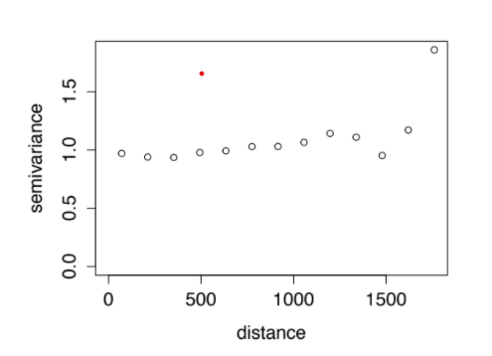
Functions to describe autocorrelation
Spherical, Linear, Ratio, Gaussian, Exponential
Continuous functions that define autocorrelation
Can compare AIC between different autocorrelation models

Slide 19

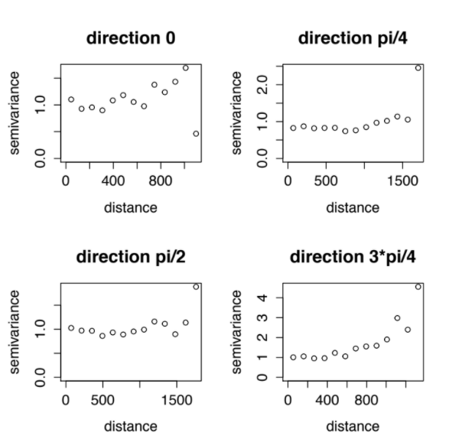
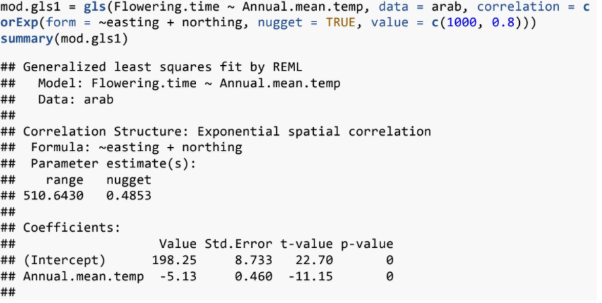
Other spatial considerations
Importance of direction

